Slide 1
Strider OS
Wilson Huang
Jacob Wroblewski
Xin
Peiqi Li

Slide 2
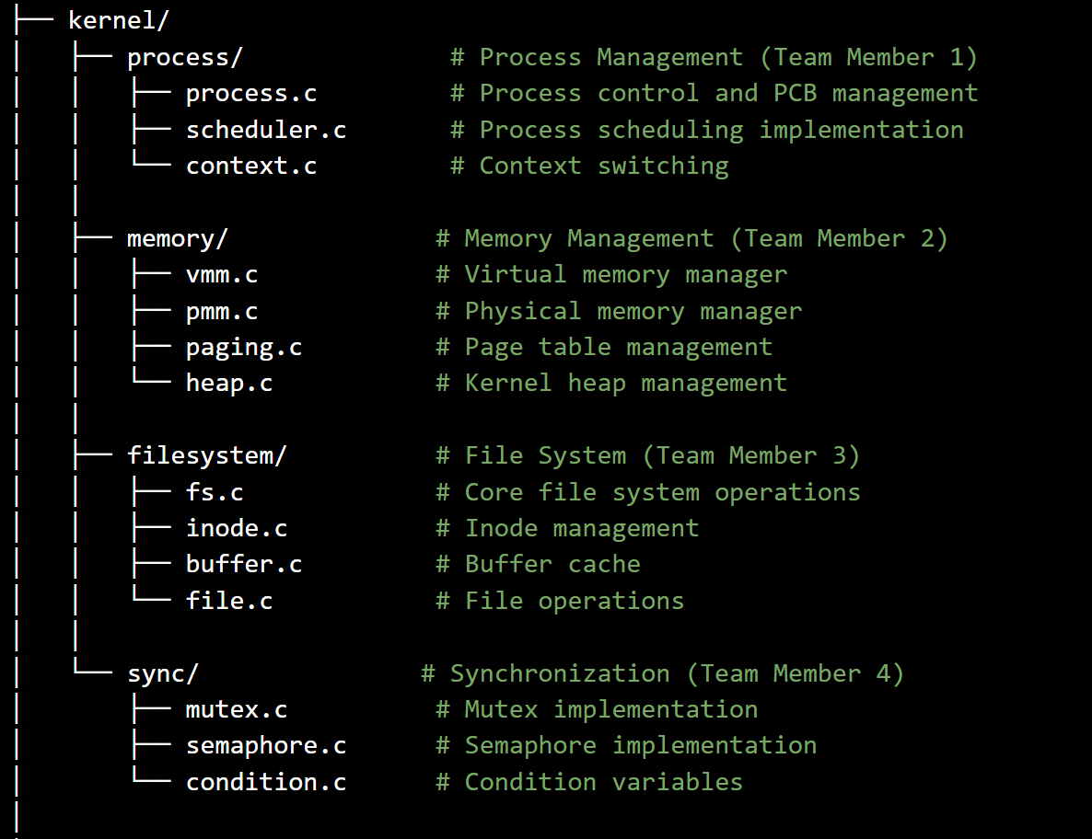
Strider OS
Wilson Huang
Jacob Wroblewski
Xin
Peiqi Li

Slide 3
Process Management Implementation
Project
Outline

Slide 4
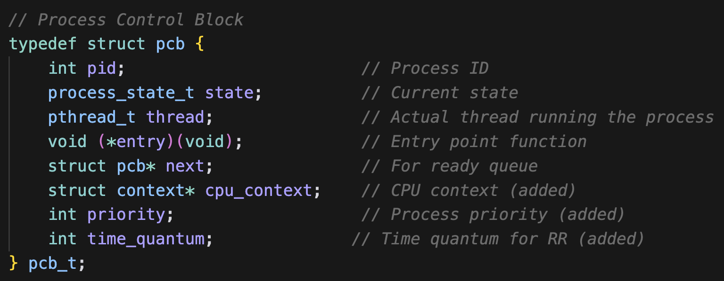
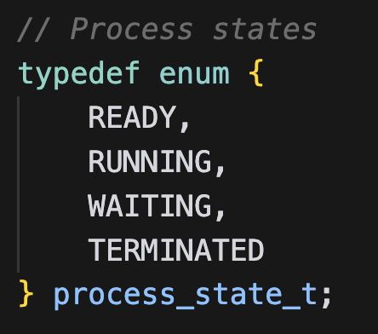
Process Management Implementation
Process control & PCB management
PCB
Process State

Slide 5
Process control & PCB management
PCB
Process State

Slide 6
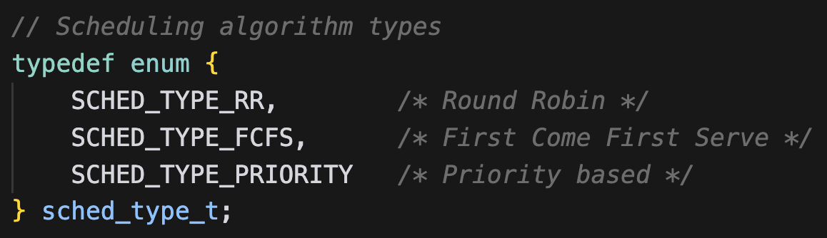
Process scheduling implementation
Varied Algorithms
Round Robin
First Come First Serve
Priority Based

Slide 7
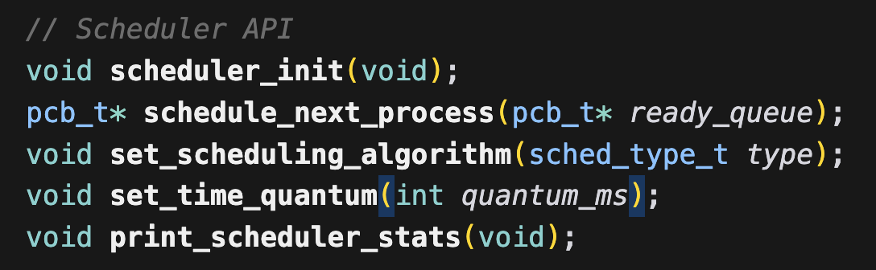
Process scheduling implementation
API Features
Next Process

Slide 8
Process scheduling implementation
API Features
Next Process
Scheduling Algorithm

Slide 9
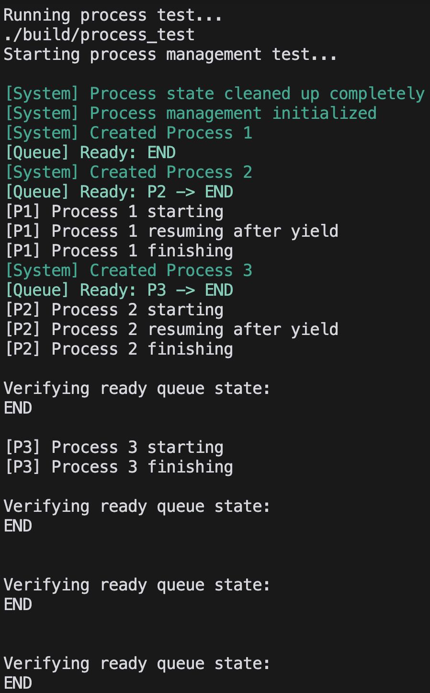
Process scheduling implementation
Shows Correct End
API Features
Next Process
Done In Order
Scheduling oAlgorithm
Everything Verified

Slide 10
Testing
Shows Correct End
Done In Order
Everything Verified

Slide 11
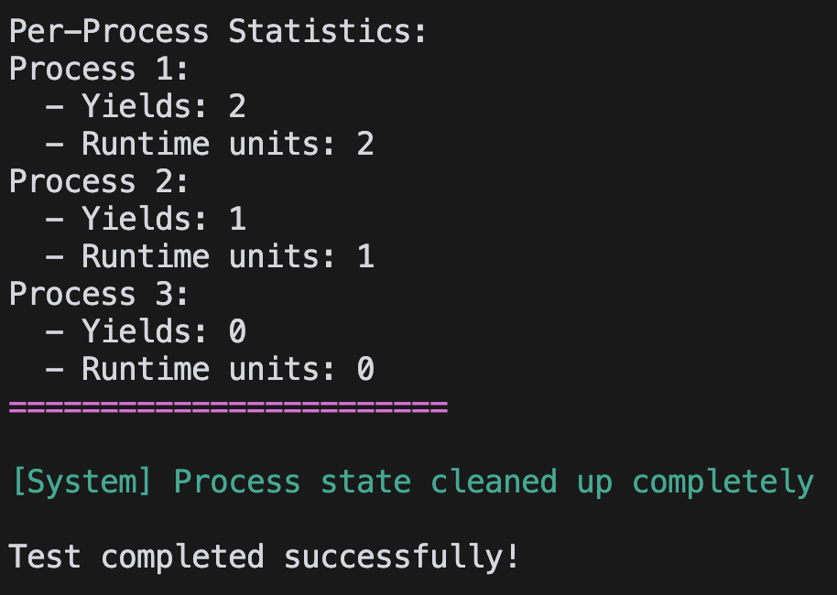
Testing
Shows Correct End
Properly Yielded
Done In Order
Properly Cleaned
Everything Verified

Slide 12
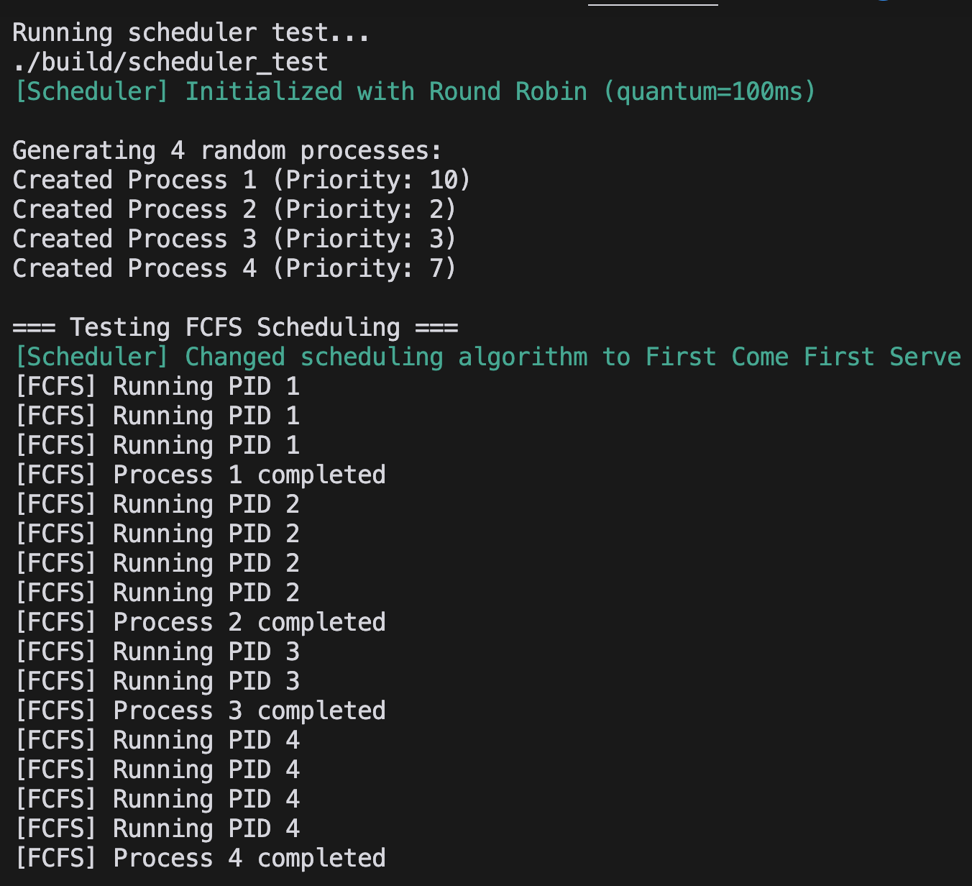
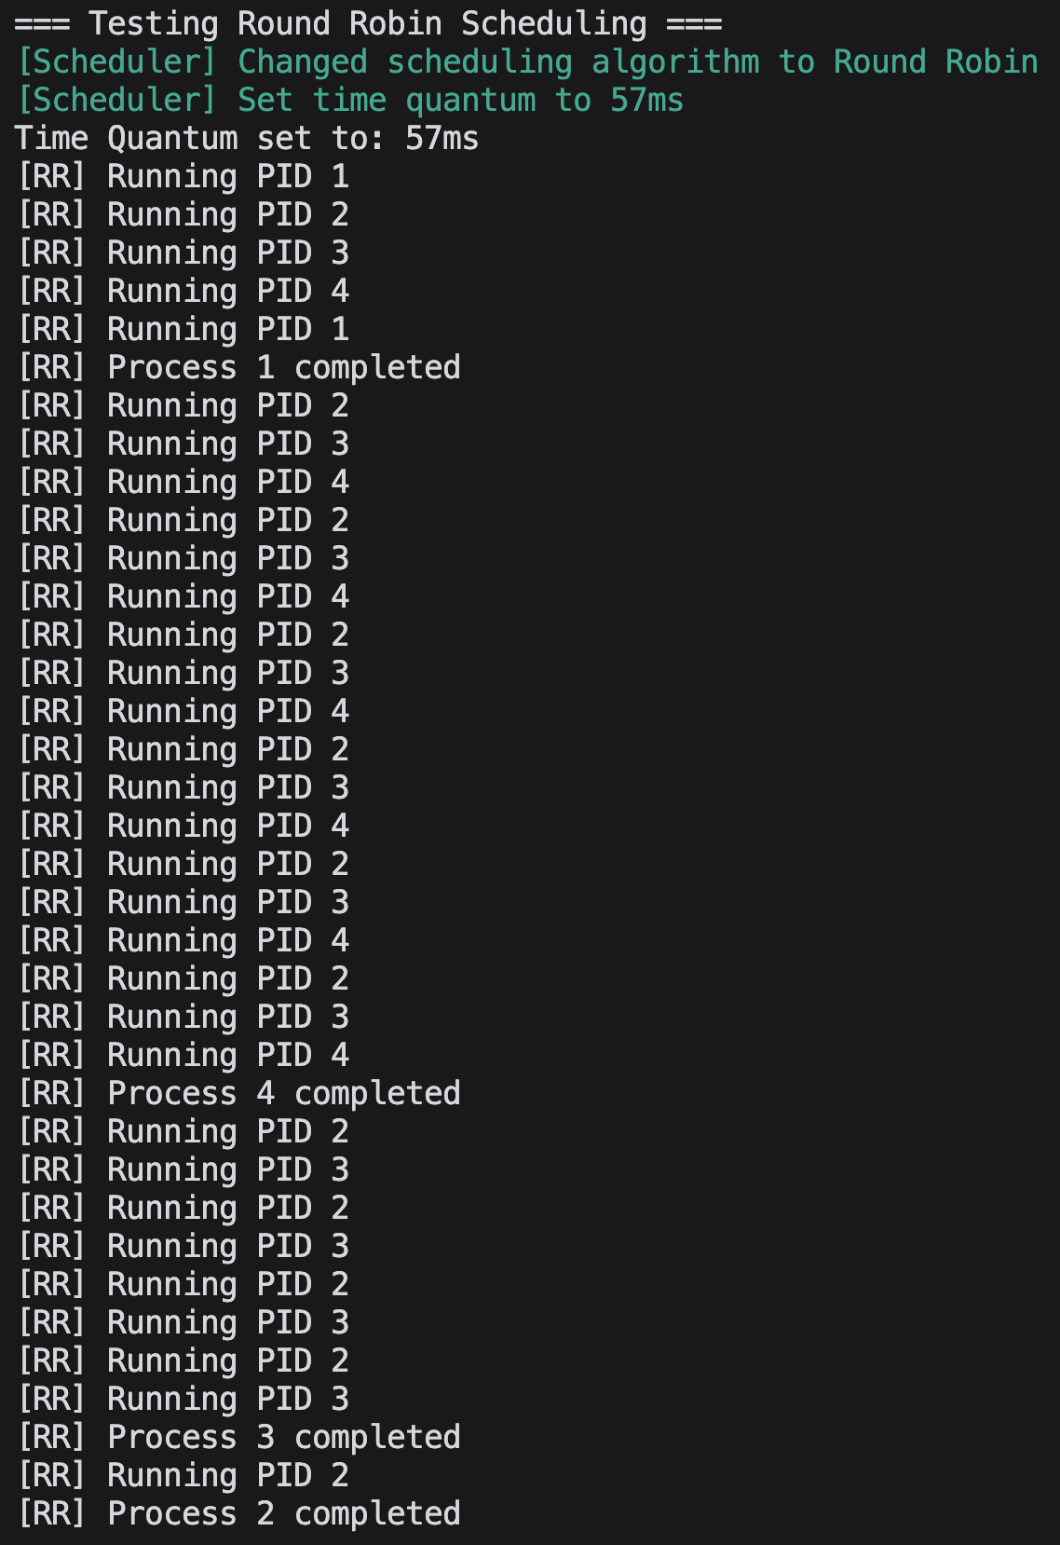
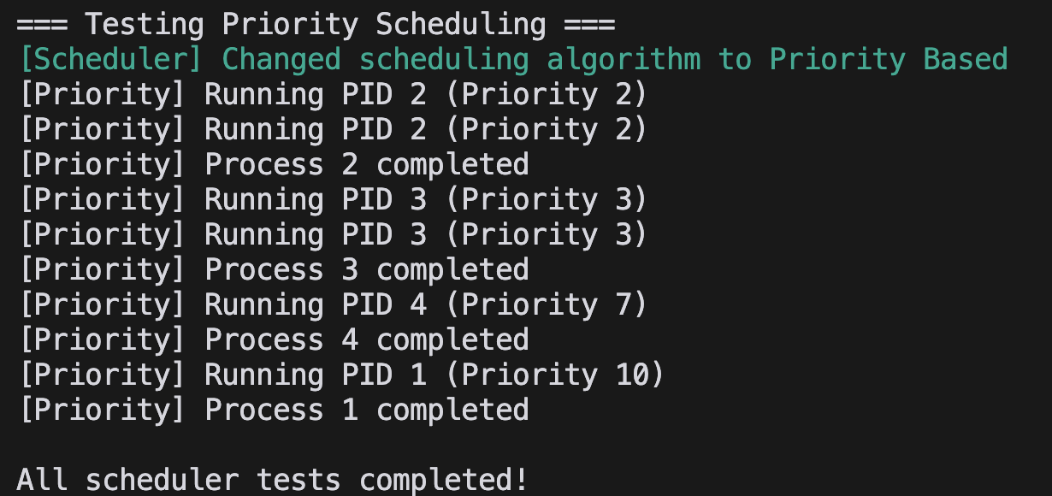
Testing
Round Robin
Priority Based
FCFS
Properly Yielded
Properly Cleaned

Slide 13
Memory Management Peiqi Li
Notes:
Introduction PART

Slide 14
Overview of Memory Management
What is Memory Management?
Importance of Memory Management in an Operating System.
Position of the Memory Management Module in SimpleOS Architecture.

Slide 15
kernel/memory/
vmm.c - Virtual Memory Manager
pmm.c - Physical Memory Manager
paging.c - Page Table Management
heap.c - Kernel Heap Management
include/kernel/memory/
vmm.h pmm.h paging.h heap.h
tests/memory_test/
Vmm_test.h pmm_test.h paging_test.h heap_test.h
Notes:
MY PART

Slide 16
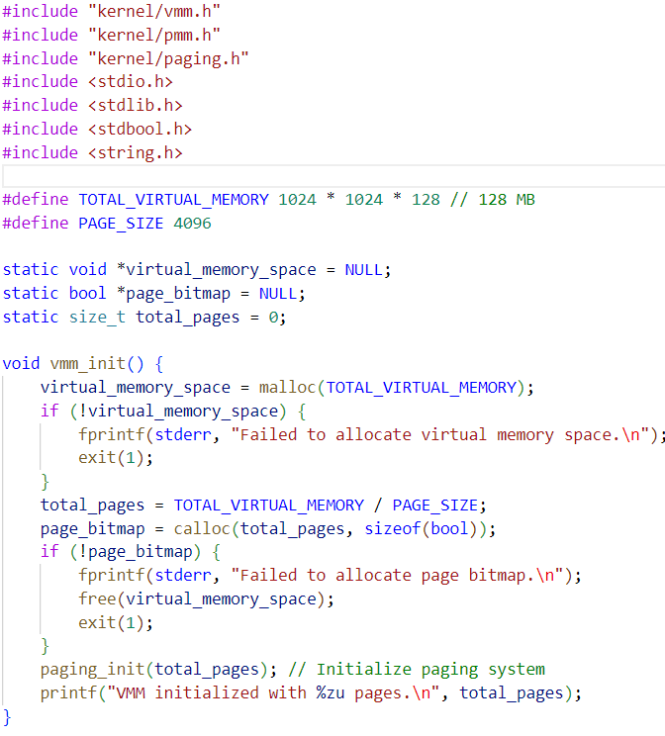
Virtual Memory Management (vmm.c)

Slide 17
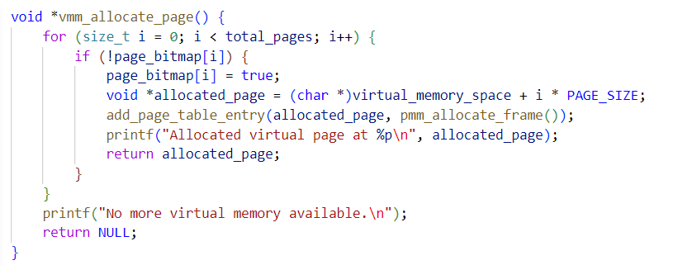
Virtual Memory Management (vmm.c)

Slide 18
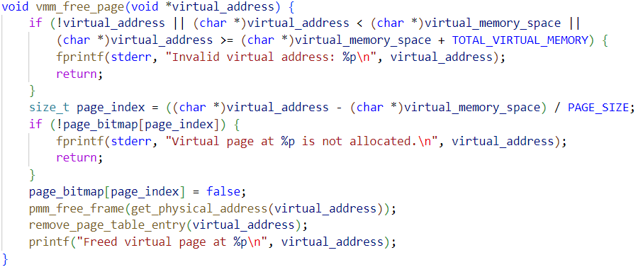
Virtual Memory Management (vmm.c)

Slide 19
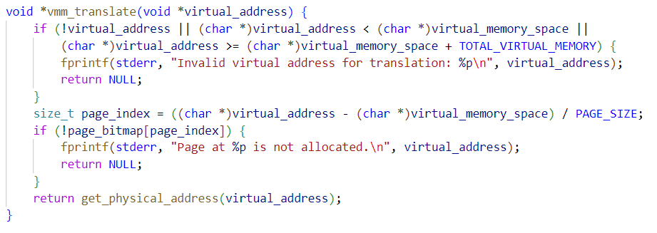
Virtual Memory Management (vmm.c)

Slide 20
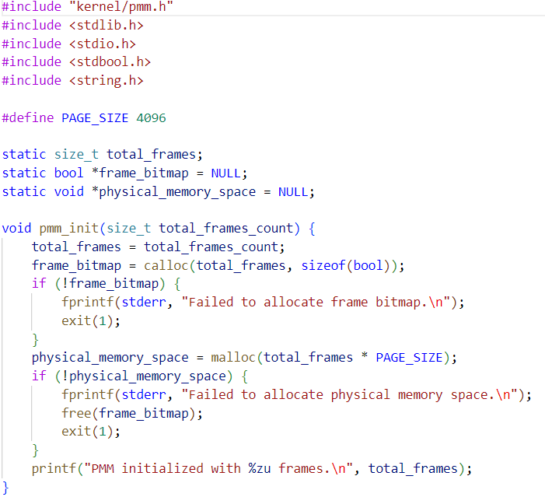
Physical Memory Management (pmm.c)

Slide 21
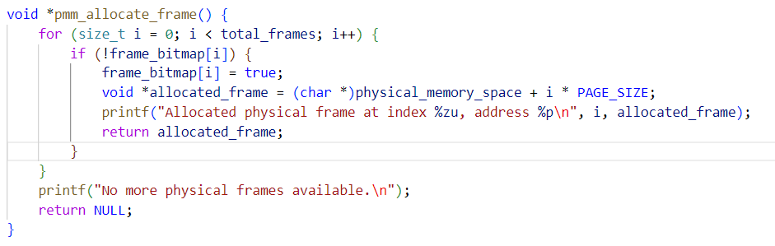
Physical Memory Management (pmm.c)

Slide 22
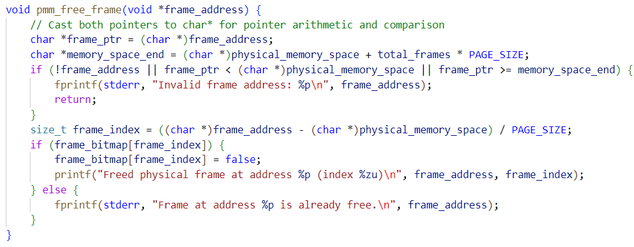
Physical Memory Management (pmm.c)

Slide 23
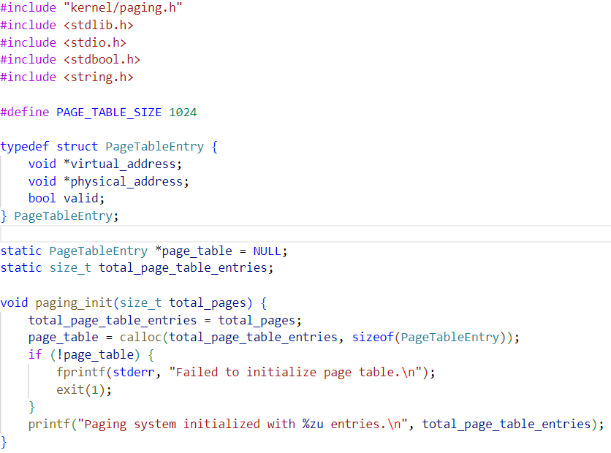
Paging and Memory Address Translation (paging.c)

Slide 24
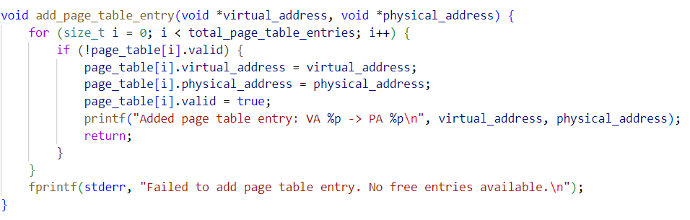
Paging and Memory Address Translation (paging.c)

Slide 25
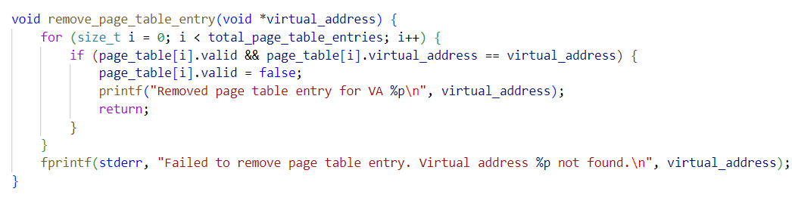
Paging and Memory Address Translation (paging.c)

Slide 26
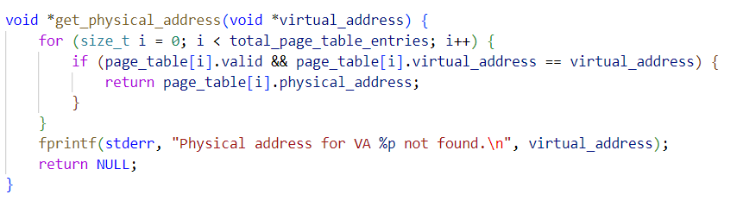
Paging and Memory Address Translation (paging.c)

Slide 27
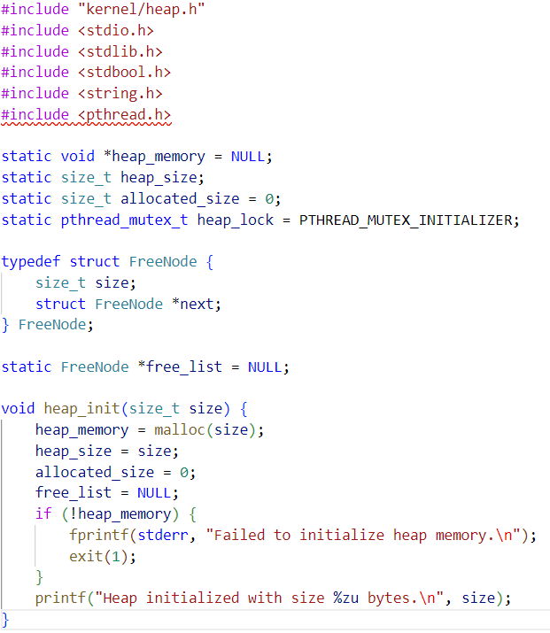
Kernel Heap Management (heap.c)

Slide 28
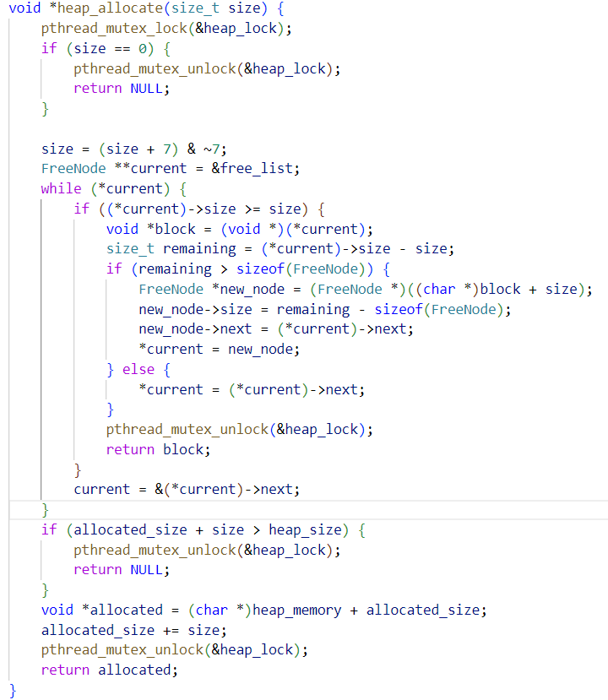
Kernel Heap Management (heap.c)

Slide 29
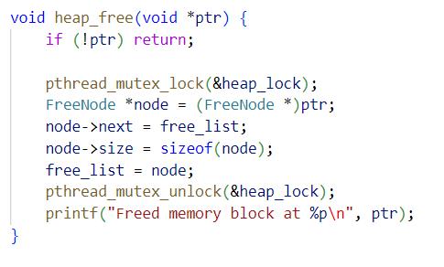
Kernel Heap Management (heap.c)

Slide 30
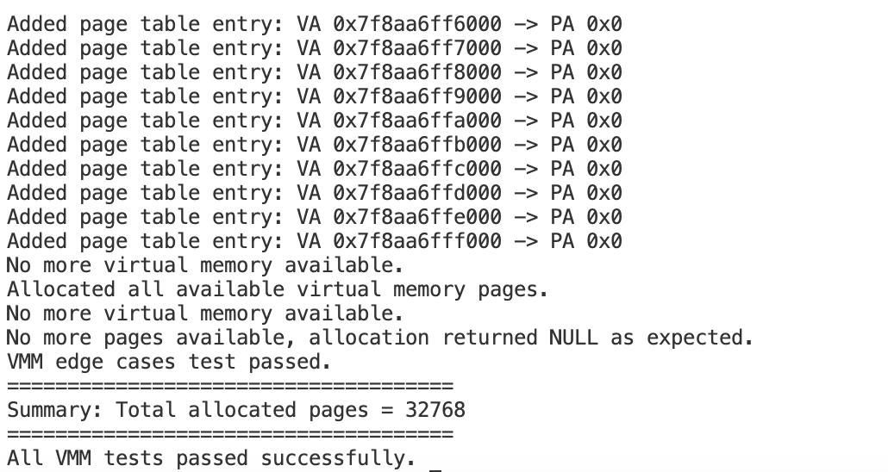
Testing

Slide 31
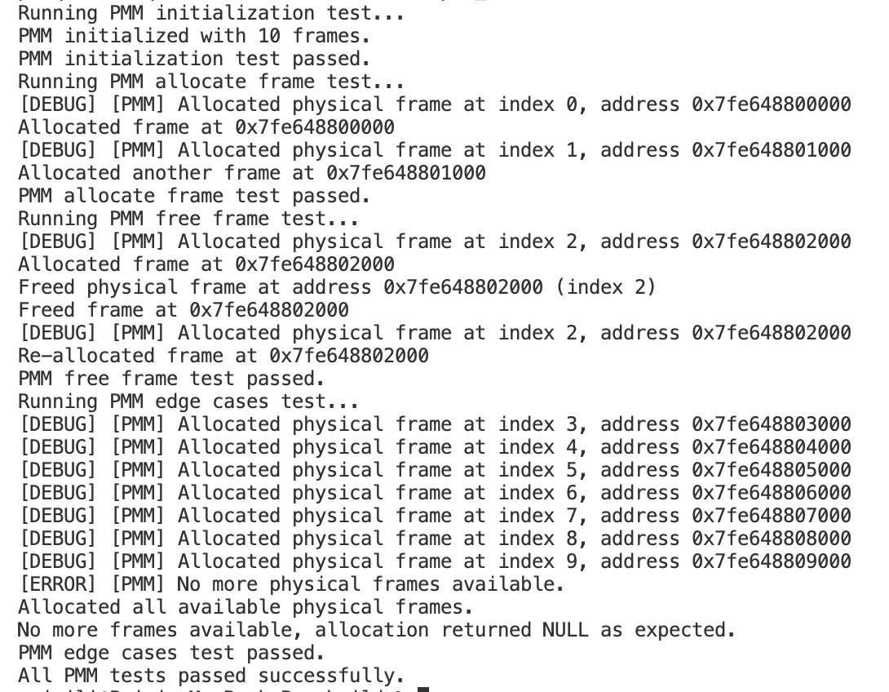
Testing

Slide 32
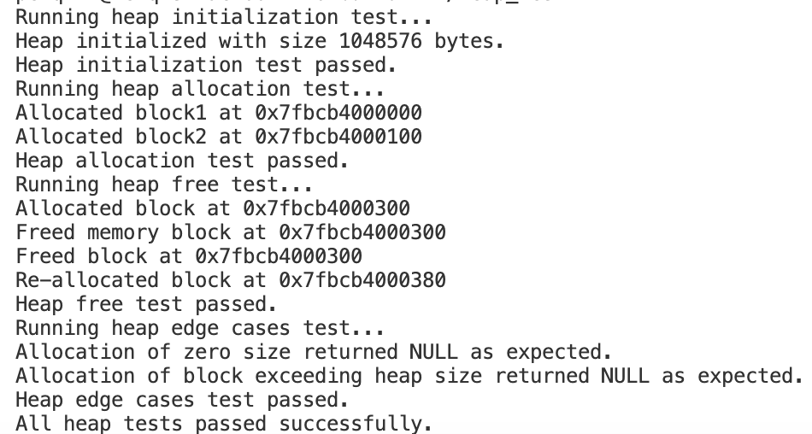
Testing

Slide 33
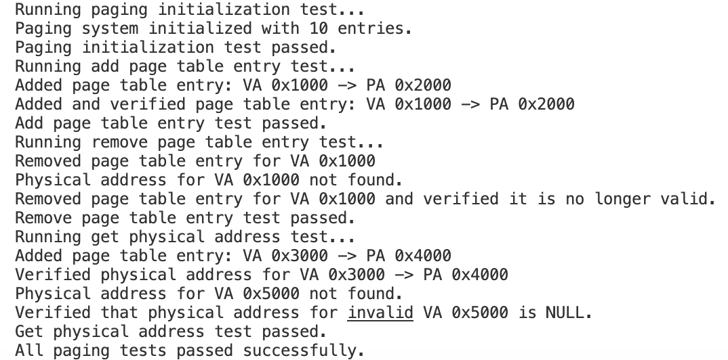
Testing

Slide 34
File System

Slide 35
Introduction to SimpleOS File System
Purpose: Provides persistent storage and management of files and directories.
Key Features:
File and directory operations (create, open, read, write, delete).
Integration with buffer cache and inode management.
Goal: Reliable, efficient, and easy-to-use file system.

Slide 36
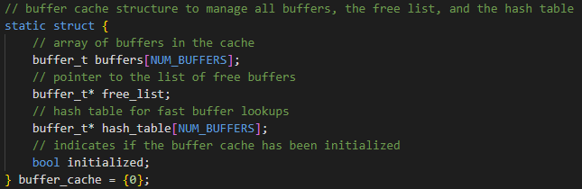
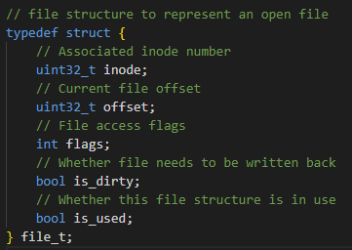
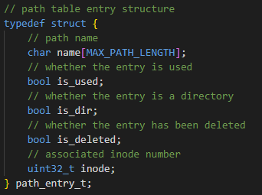
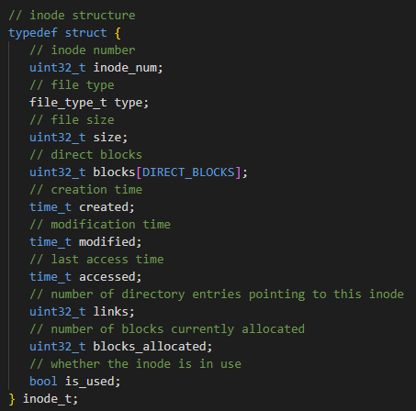
System Architecture
Core Components:
File Descriptor Table: Tracks open files.
Path Table: Manages file/directory metadata.
Inode Management: Handles file/directory metadata.
Buffer Cache: Ensures efficient data storage and retrieval.
Integration:
Leverages existing subsystems for robustness and reusability.

Slide 37
System Architecture
Core Components:
File Descriptor Table: Tracks open files.
Path Table: Manages file/directory metadata.
Inode Management: Handles file/directory metadata.
Buffer Cache: Ensures efficient data storage and retrieval.
Integration:
Leverages existing subsystems for robustness and reusability.

Slide 38
System Architecture
Core Components:
File Descriptor Table: Tracks open files.
Path Table: Manages file/directory metadata.
Inode Management: Handles file/directory metadata.
Buffer Cache: Ensures efficient data storage and retrieval.
Integration:
Leverages existing subsystems for robustness and reusability.

Slide 39
System Architecture
Core Components:
File Descriptor Table: Tracks open files.
Path Table: Manages file/directory metadata.
Inode Management: Handles file/directory metadata.
Buffer Cache: Ensures efficient data storage and retrieval.
Integration:
Leverages existing subsystems for robustness and reusability.

Slide 40
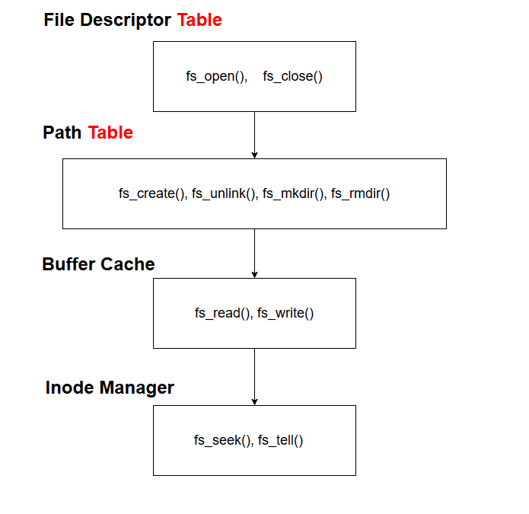
File System Architecture Map with API functions

Slide 41
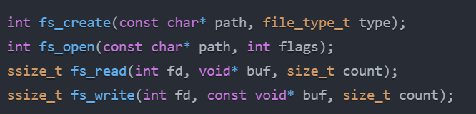
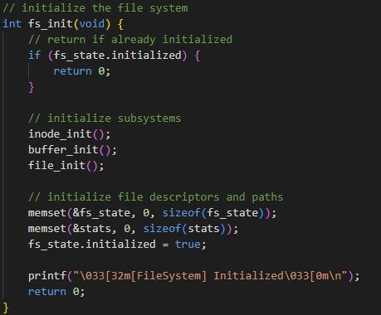
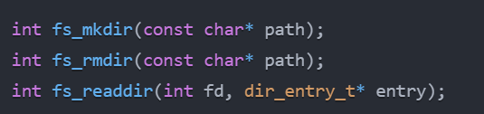
Key API Functions
Initialization: fs_init(), fs_cleanup().
File Operations:
Create/Delete: fs_create(), fs_unlink().
Open/Close: fs_open(), fs_close().
Read/Write: fs_read(), fs_write().
Positioning: fs_seek(), fs_tell().
Directory Operations:
Create/Delete: fs_mkdir(), fs_rmdir().
Read Entries: fs_readdir().
Statistics: fs_get_stats(), fs_print_stats().

Slide 42
Key API Functions
Initialization: fs_init(), fs_cleanup().
File Operations:
Create/Delete: fs_create(), fs_unlink().
Open/Close: fs_open(), fs_close().
Read/Write: fs_read(), fs_write().
Positioning: fs_seek(), fs_tell().
Directory Operations:
Create/Delete: fs_mkdir(), fs_rmdir().
Read Entries: fs_readdir().
Statistics: fs_get_stats(), fs_print_stats().

Slide 43
Key API Functions
Initialization: fs_init(), fs_cleanup().
File Operations:
Create/Delete: fs_create(), fs_unlink().
Open/Close: fs_open(), fs_close().
Read/Write: fs_read(), fs_write().
Positioning: fs_seek(), fs_tell().
Directory Operations:
Create/Delete: fs_mkdir(), fs_rmdir().
Read Entries: fs_readdir().
Statistics: fs_get_stats(), fs_print_stats().

Slide 44
Implementation Highlights
File Descriptor Management:
Allocates descriptors from fs_state.open_files.
Path Management:
Functions: find_path(), add_path(), remove_path().

Slide 45
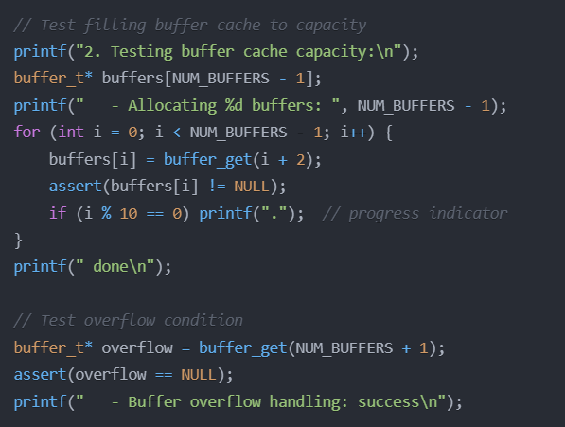
More Highlights - Case: Buffer Cache Overflow Prevention
Fill 63 of 64 buffers → verify allocation success
Request 65th buffer → verify NULL return
Visual progress tracking every 10 allocations
Automatic overflow prevention via free list

Slide 46
Limitations and Future Work
Current Limitations:
Fixed-size tables.
No advanced features (e.g., links, permissions).
Future Enhancements:
Dynamic data structures for scalability.
Support for links and permissions.
Performance optimizations (e.g., caching, asynchronous I/O).
Journaling for reliability.

Slide 47
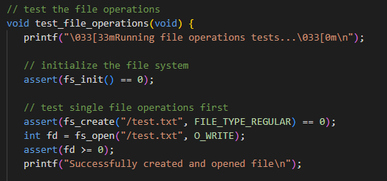
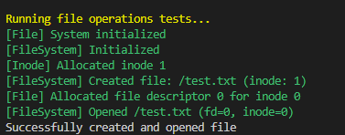
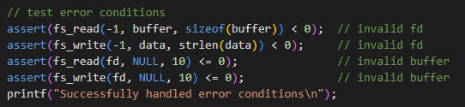
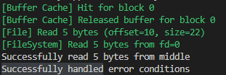
Testing
Validates API functions, edge cases, and subsystem integration.
API functions:
Edge cases:

Slide 48
//Synchronization

Slide 49
the purpose of synchronization is to ensure that threads don’t access portions of code that would clash
Synchronization
Features
To accomplish this, we implemented two files
Mutex.c
Semaphore.c

Slide 50
Synchronization
the purpose of synchronization is to ensure that threads don’t access portions of code that would clash
Features
To accomplish this, we implemented two files
//Mutex.c
//Semaphore.c

Slide 51
Key Operations
Mutex.c
Mutex.c
Semaphore.c

Slide 52
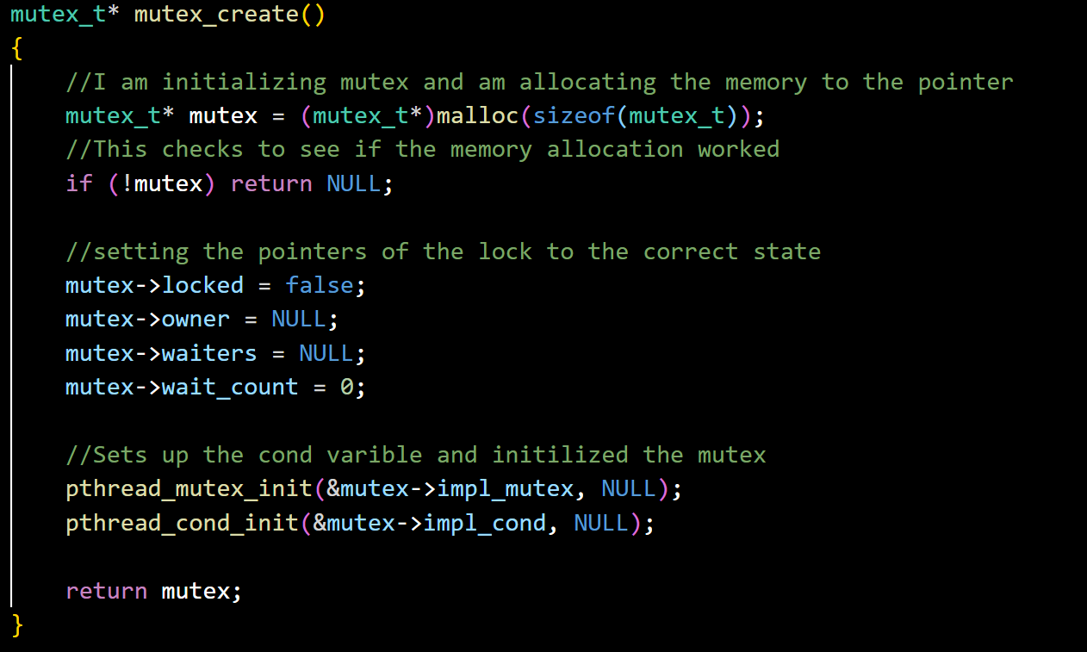
Mutex.c
Key Operations
Semaphore.c

Slide 53
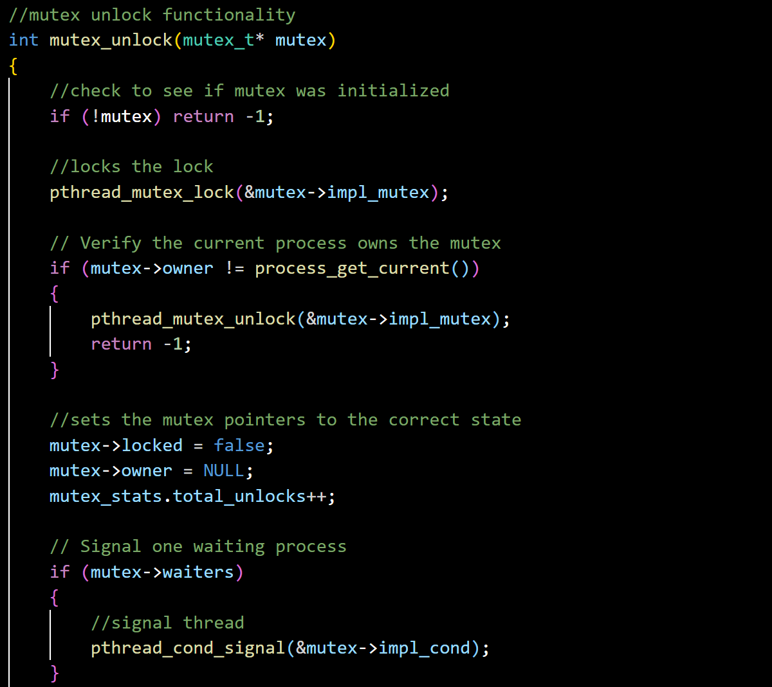
Semaphore.c
Mutex.c
Key Operations

Slide 54
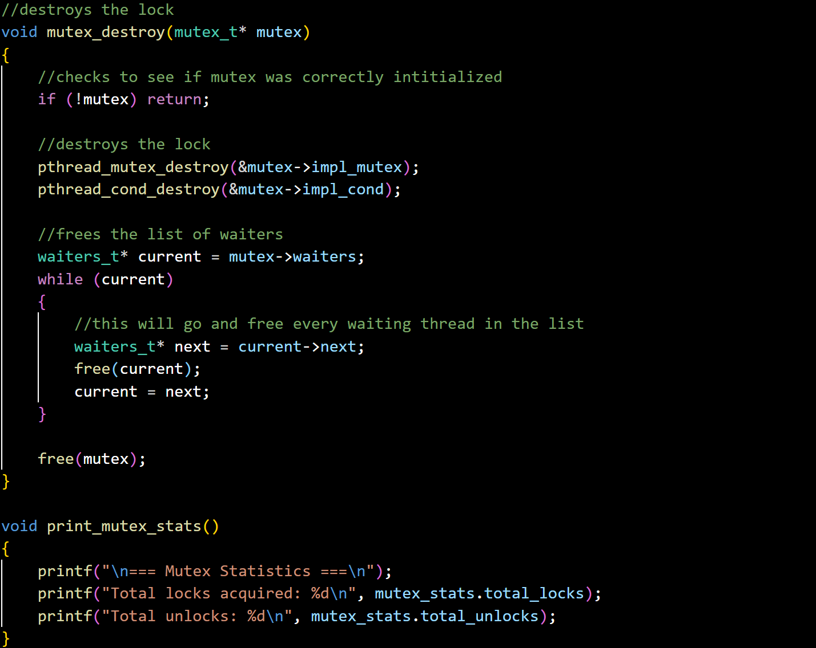
//Key Operations
//Mutex.c

Slide 55
//Key Operations
//Mutex.c

Slide 56
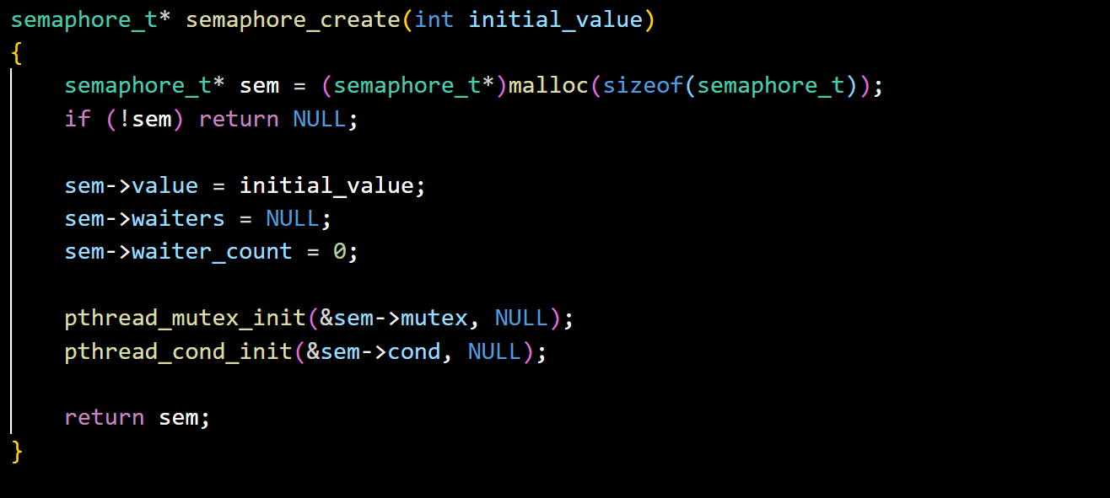
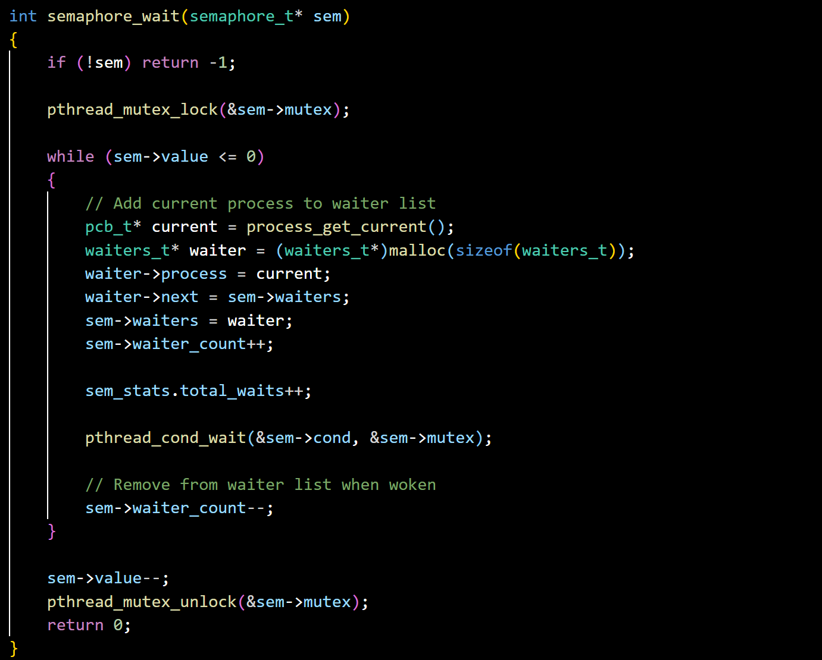
Semaphore.c
Key Operations

Slide 57
Semaphore.c
Key Operations

Slide 58
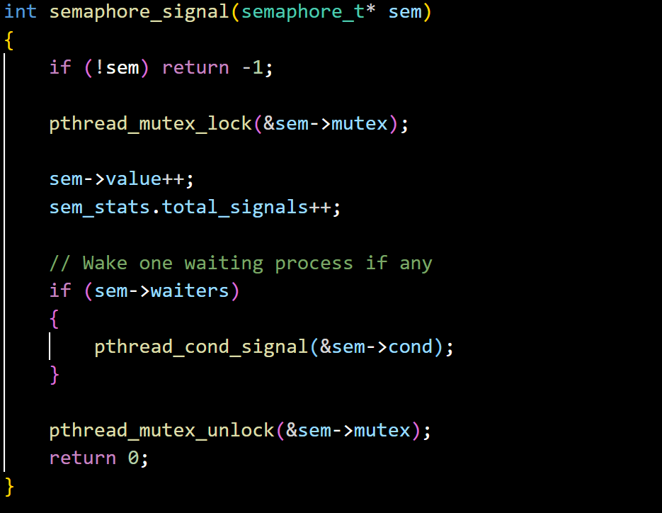

Slide 59
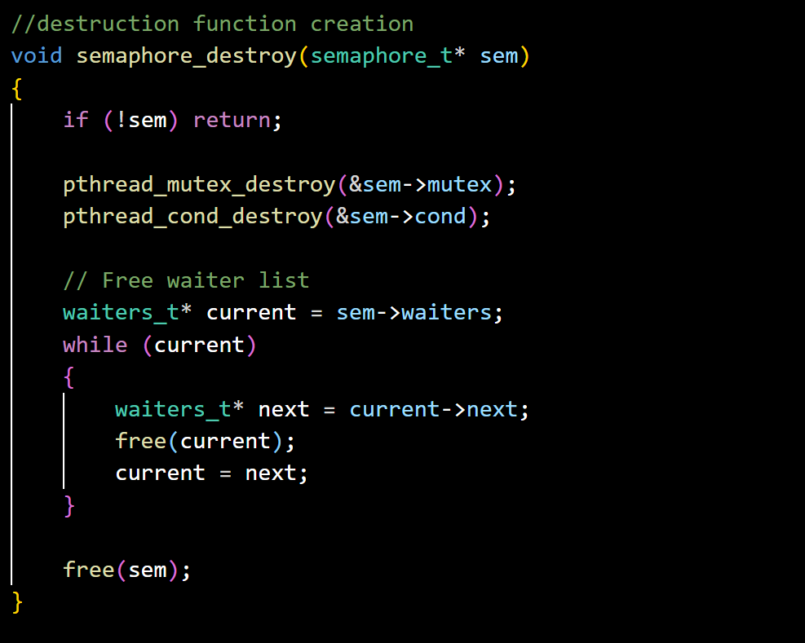
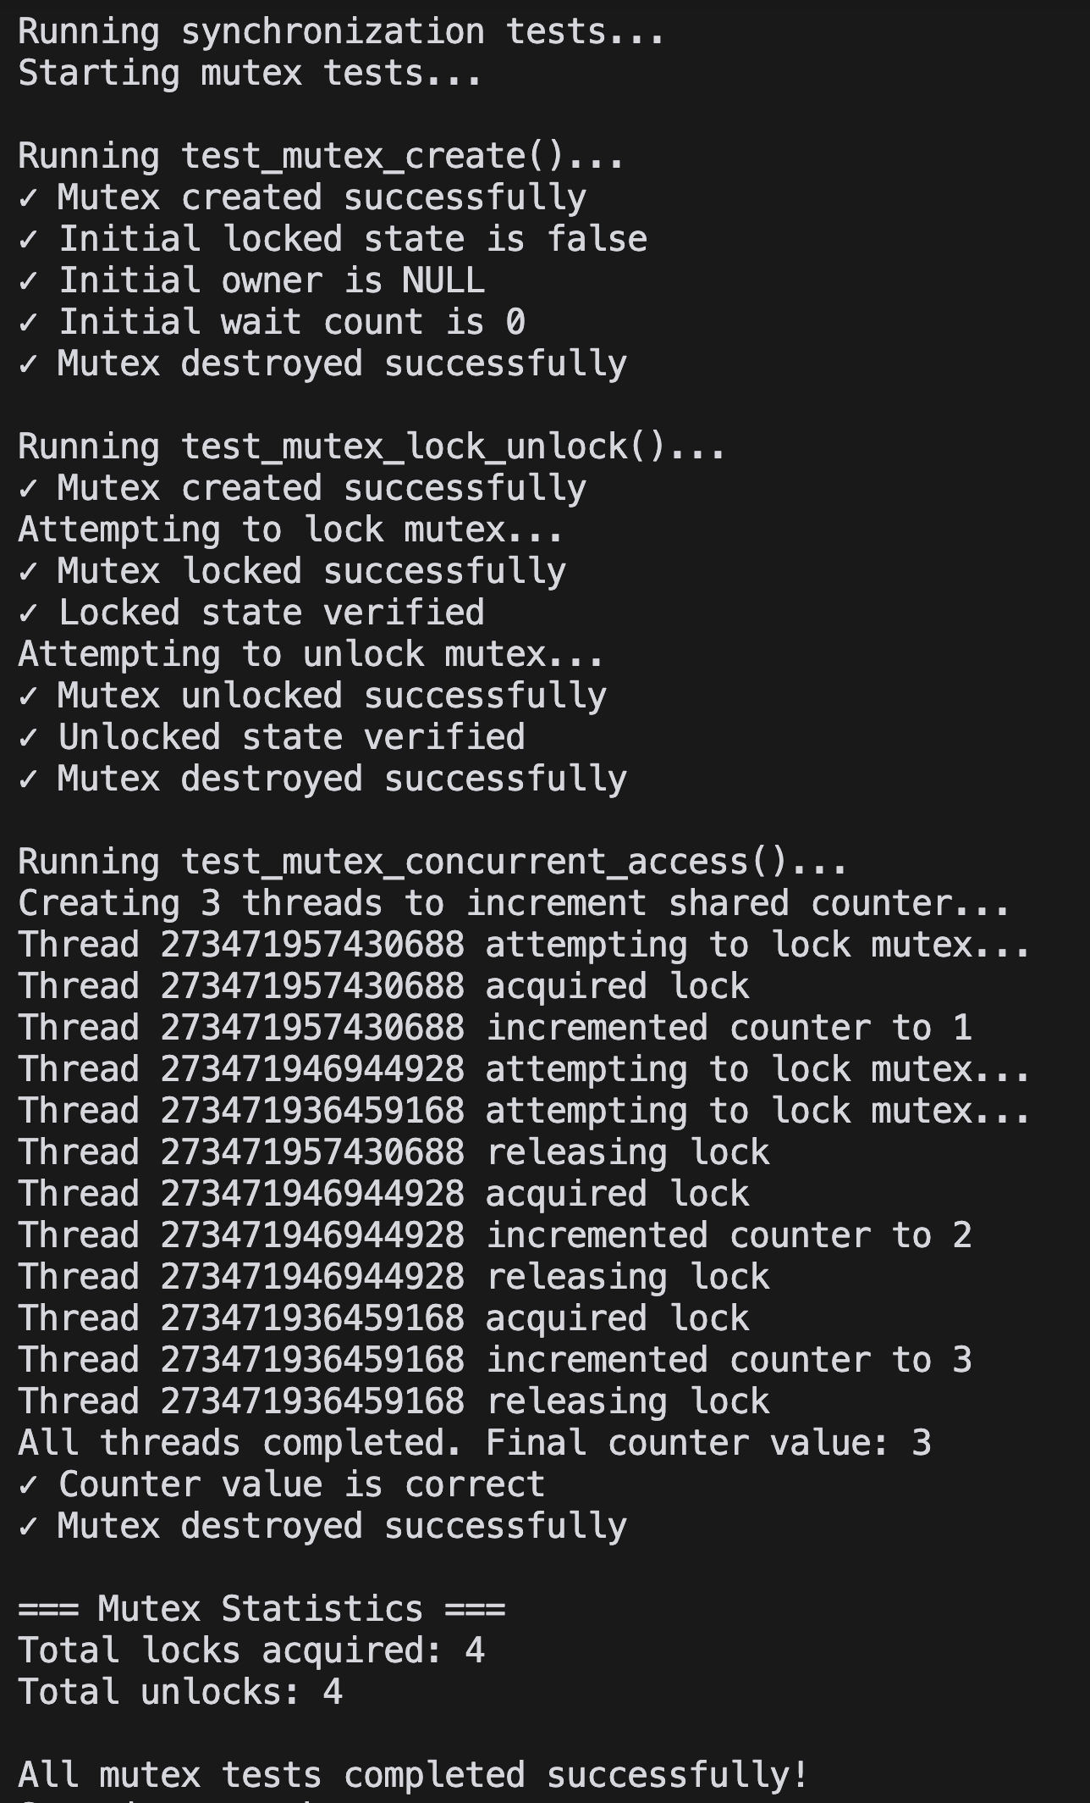
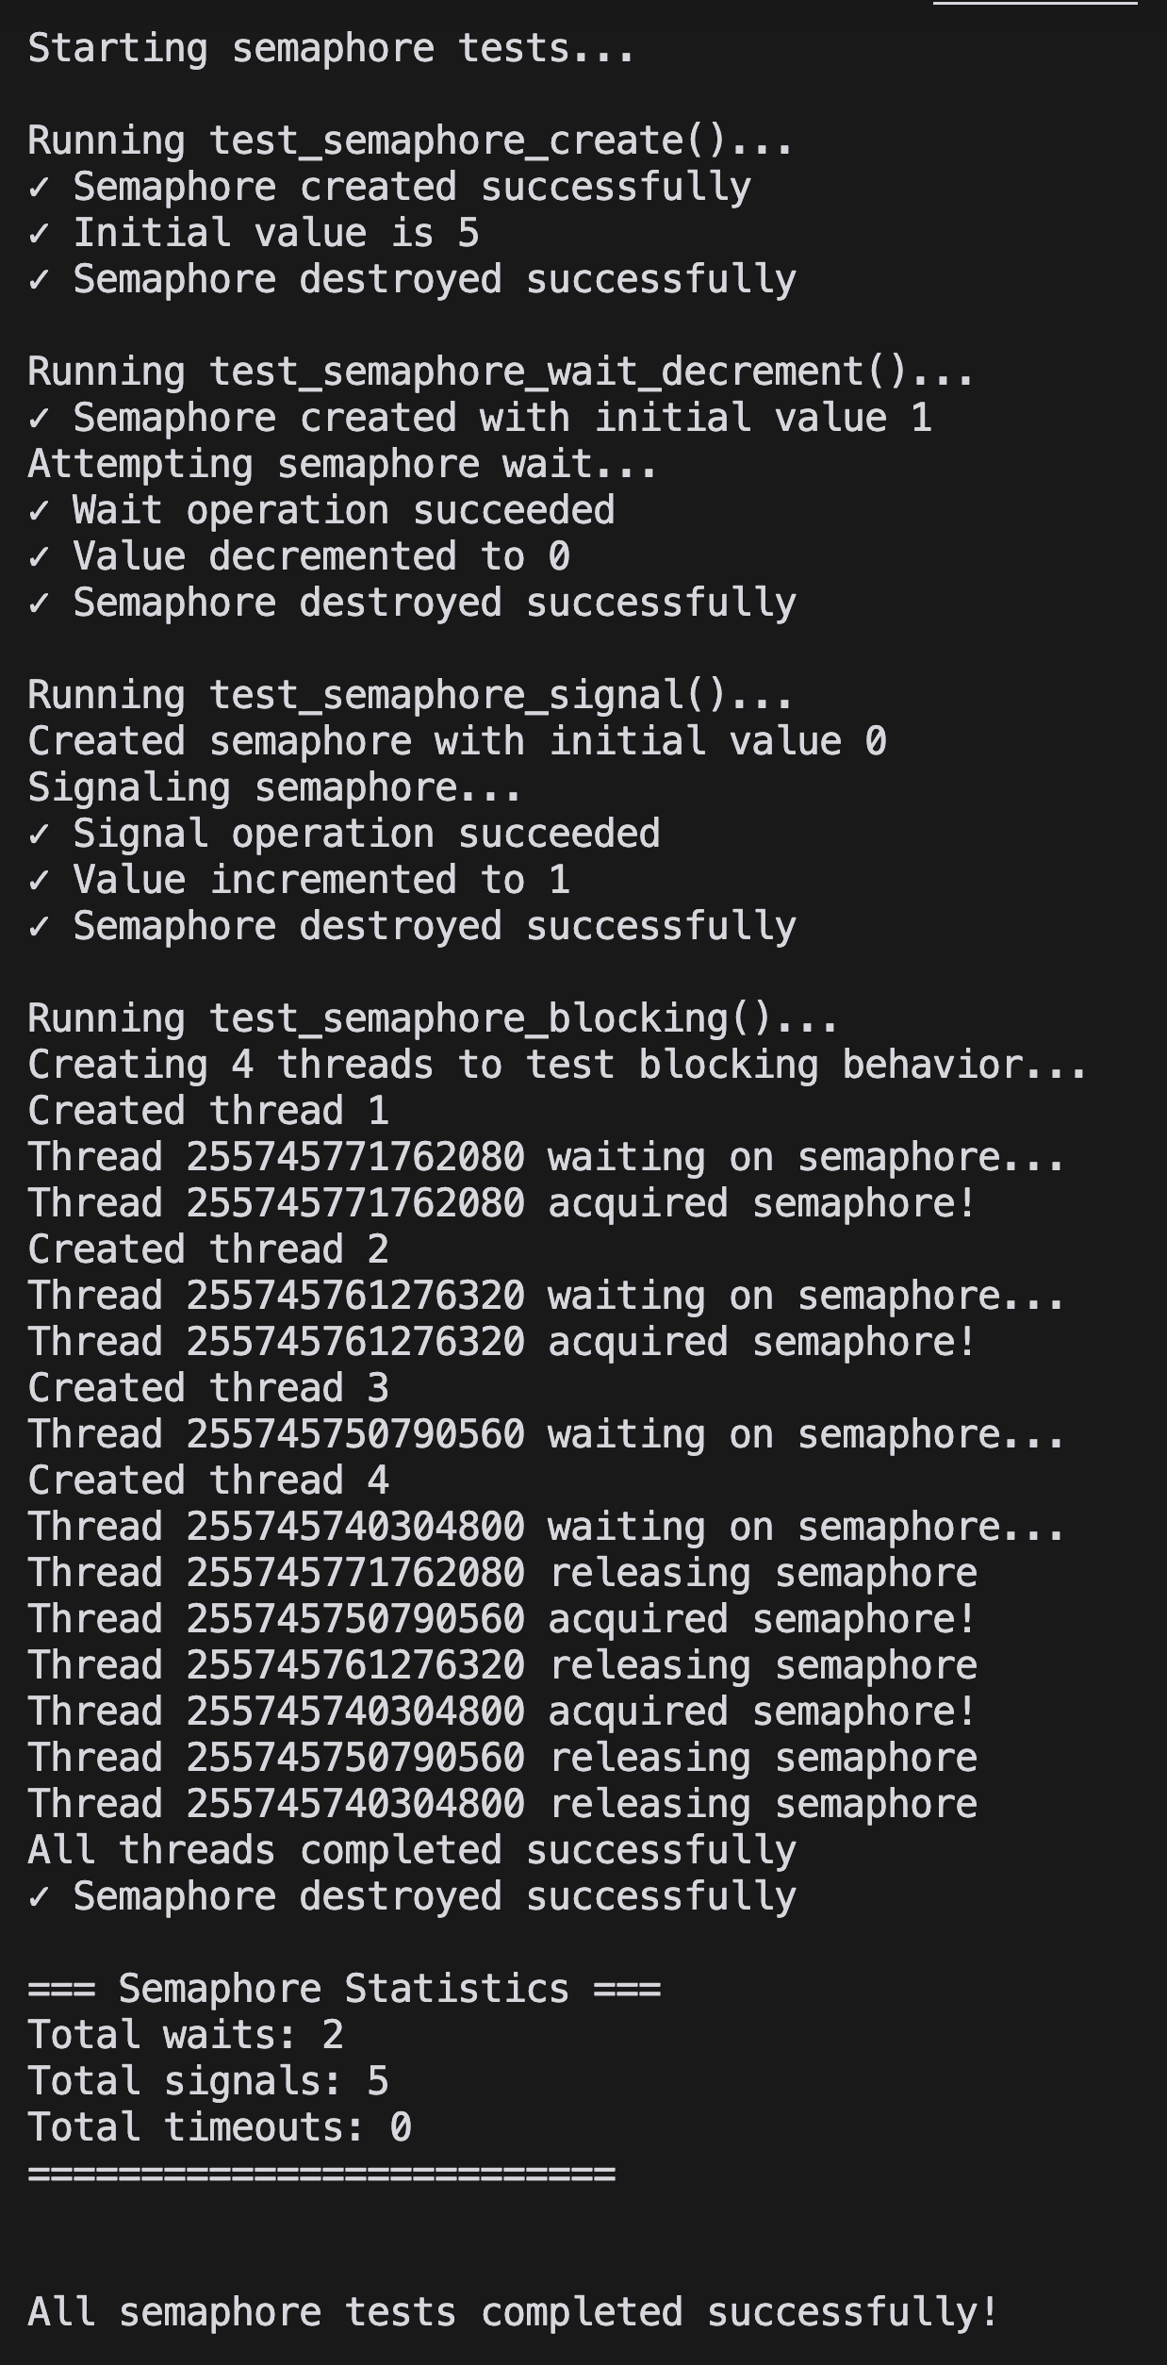
Correctly locked
Correctly Blocking
Correctly unlocked
Correctly Waiting

Slide 60


Testing
Correctly locked
Correctly Blocking
Correctly unlocked
Correctly Waiting

Slide 61
Conclusion
Developmental Issues
Differing OS systems
Makefile Complications
Testing Complications
Integration Issues
Testing limited on an Individual scale

Slide 62
Conclusion
Moving Forward
Adding different functionality
I/O Management
Security Features
Developmental Issues
Differing OS systems
Makefile Complications
Testing Complications
Integration Issues
Testing limited on an Individual scale

